Slide 1
Imdb movie ANALYTICS
-final project-1

Slide 2
PROJECT DESCRIPTION:
The project is all about analyzing IMDB movie data and drawing meaningful insights from it. The success of a movie, as defined by its IMDB rating, is crucial for movie producers, directors, and investors. Understanding factors such as genre, director, budget, and actors can provide valuable insights for future movie projects.
The project data is given in an Excel sheet, which should be cleaned and made ready for analysis.

Slide 3
TECH STACK USED:
SOFTWARE: MICROSOFT 365 WEB:
I used microsoft 365 web(EXCEL) online website to perform the excel operations.As the excel app is paid platform,I have used the online free site.It had all the operations of new version of excel(2021).
OPERATING SYSTEM: MacOS
My device is MacOs.I have used it as it is stable and efficient.

Slide 4
APPROACH:
DATA CLEANING:
The team has given us one dataset(excel) with name IMDB_MOVIES.
The given data was not cleaned and preprocessed,that means it is not ready to analyze.
So I have started the project by Cleaning the Dataset.
First I made the table by using the data columns provided,then I deleted the unnecessary columns.

Slide 5
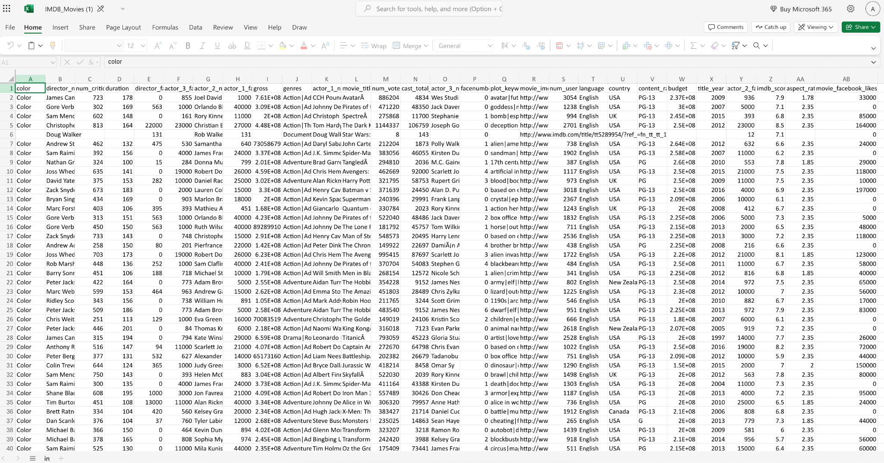
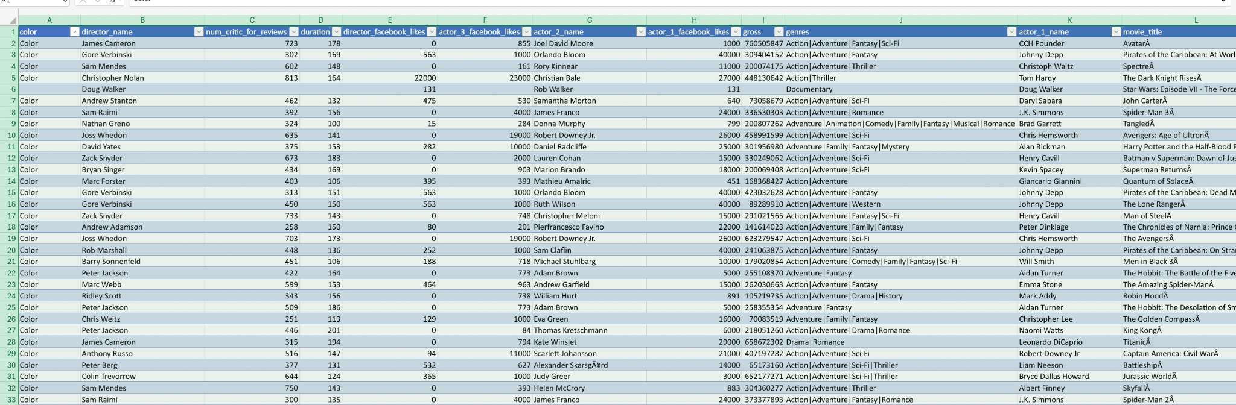
←RAW DATA
Created table →

Slide 6
APPROACH:
DATA CLEANING:
The unnecessary columns are :
color
Num_critic_for_review
Director_facebook_likes
actor_2_name
actor_3_facebook_likes
actor_1_facebook_likes
actor_1_name
Num_voted_users
•cast_total_facebook_likes
•actor_3_name
•facenumber_in_poster
•plot_keywords
•movie_imdb_link
•num_user_for_reviews
•content_rating
•title_year
•actor_2_facebook_likes
•aspect_ratio
•movie_facebook_likes

Slide 7
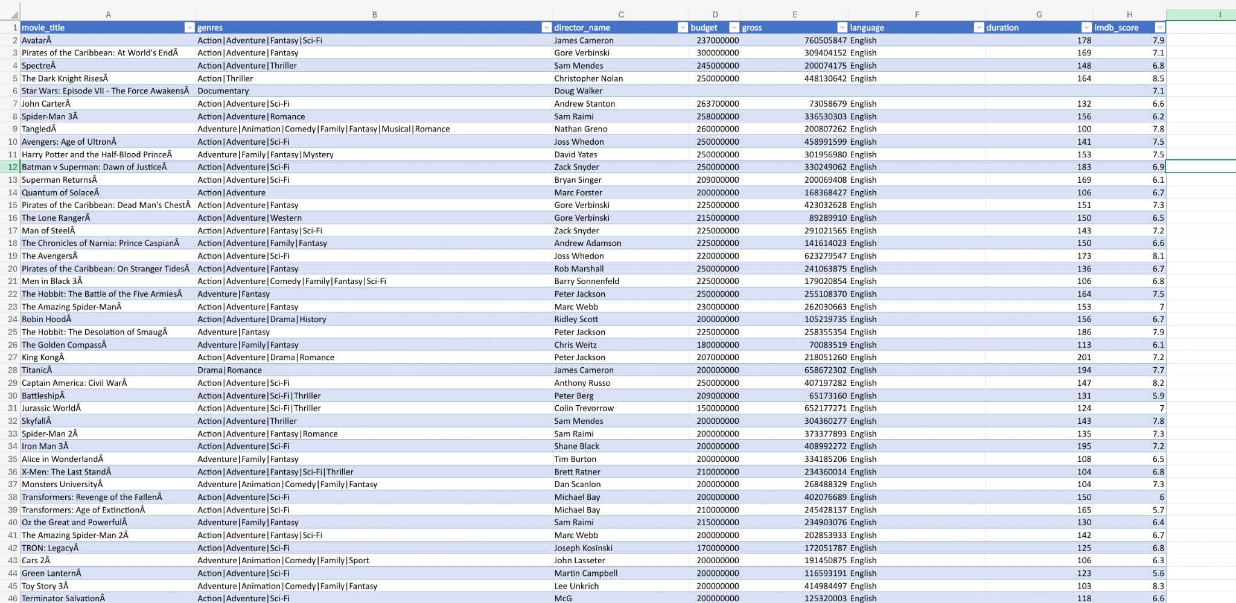
After deleting unnecessary columns,

Slide 8
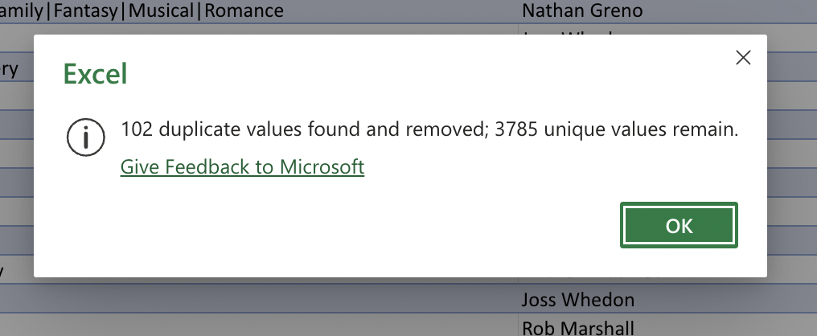
I individually set blank as filter for columns and deleted the blank rows from the dataset.
As the movie_title should be unique,I have deleted the duplicate rows by excel operation “delete duplicates”

Slide 9
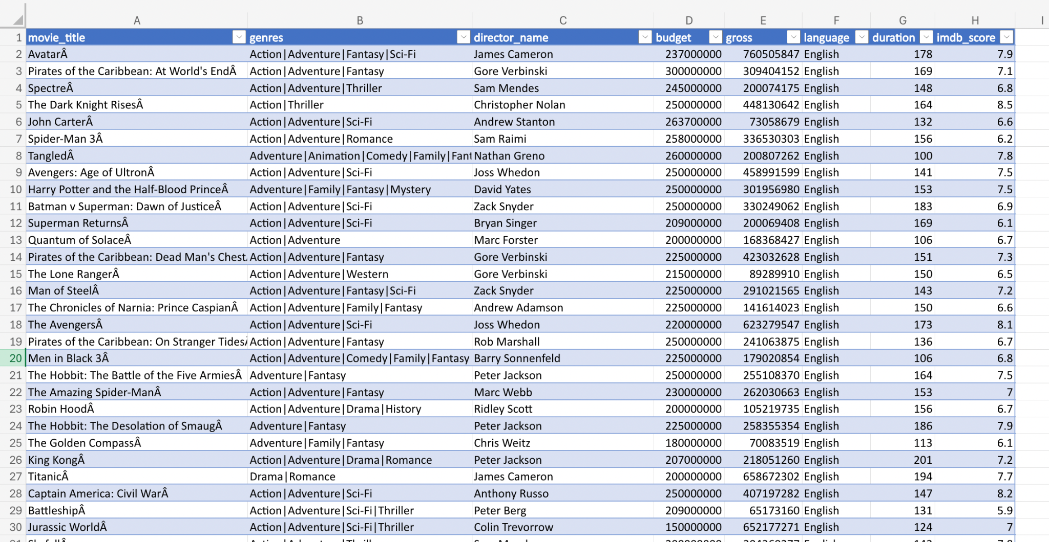
After all data cleaning the dataset is in below form

Slide 10
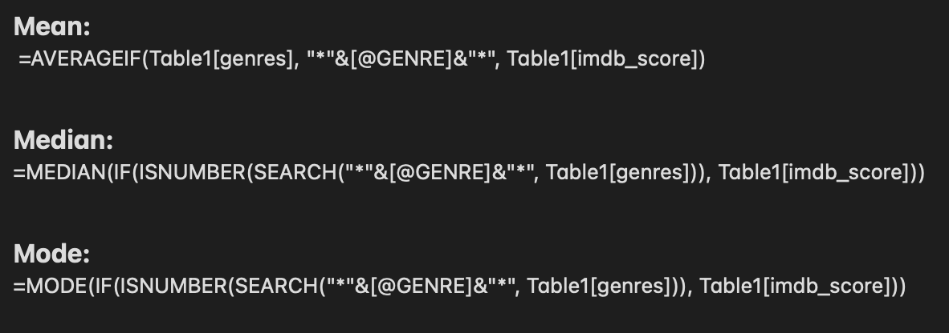
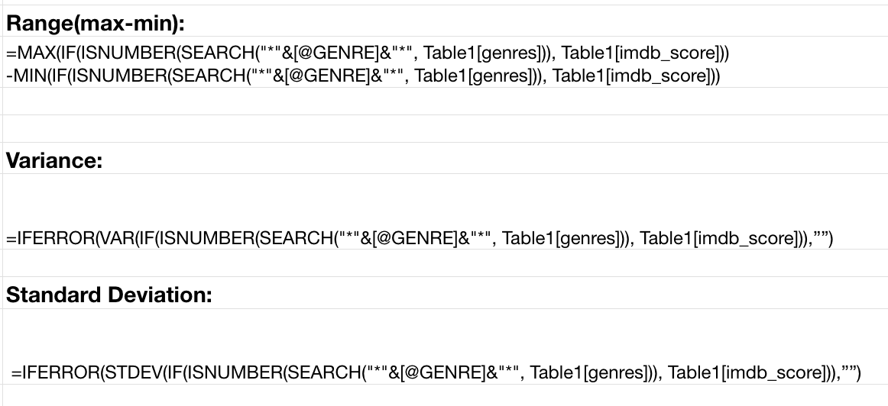
DATA ANALYTIC TASKS:
A. Movie Genre Analysis:
Determine the most common genres of movies in the dataset. Then, for each genre, calculate descriptive statistics (mean, median, mode, range, variance, standard deviation) of the IMDB scores.
Formulas used:

Slide 11
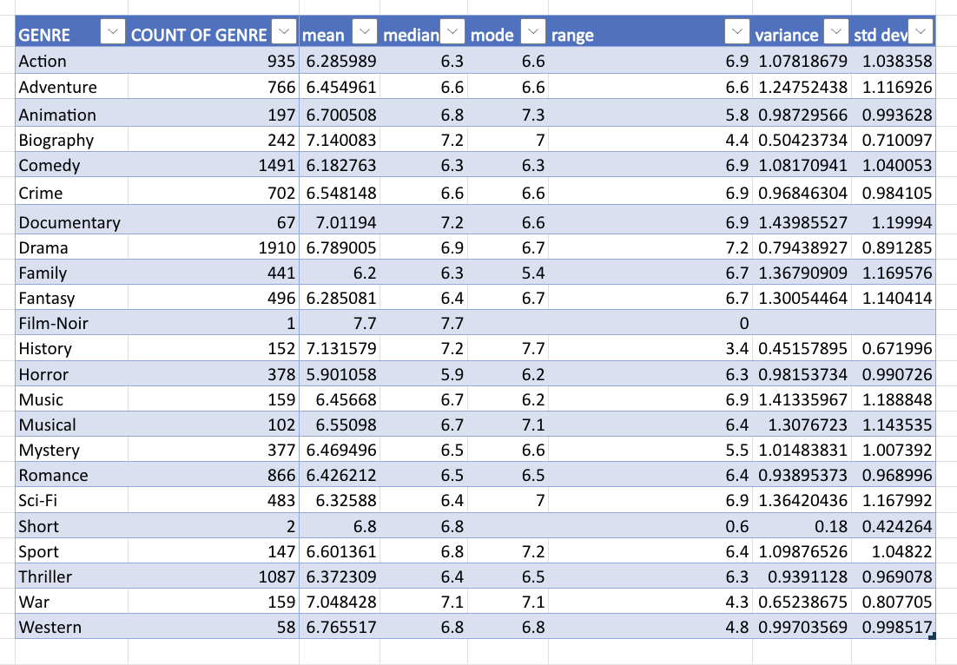
DATA ANALYTIC TASKS:
A. Movie Genre Analysis:

Slide 12
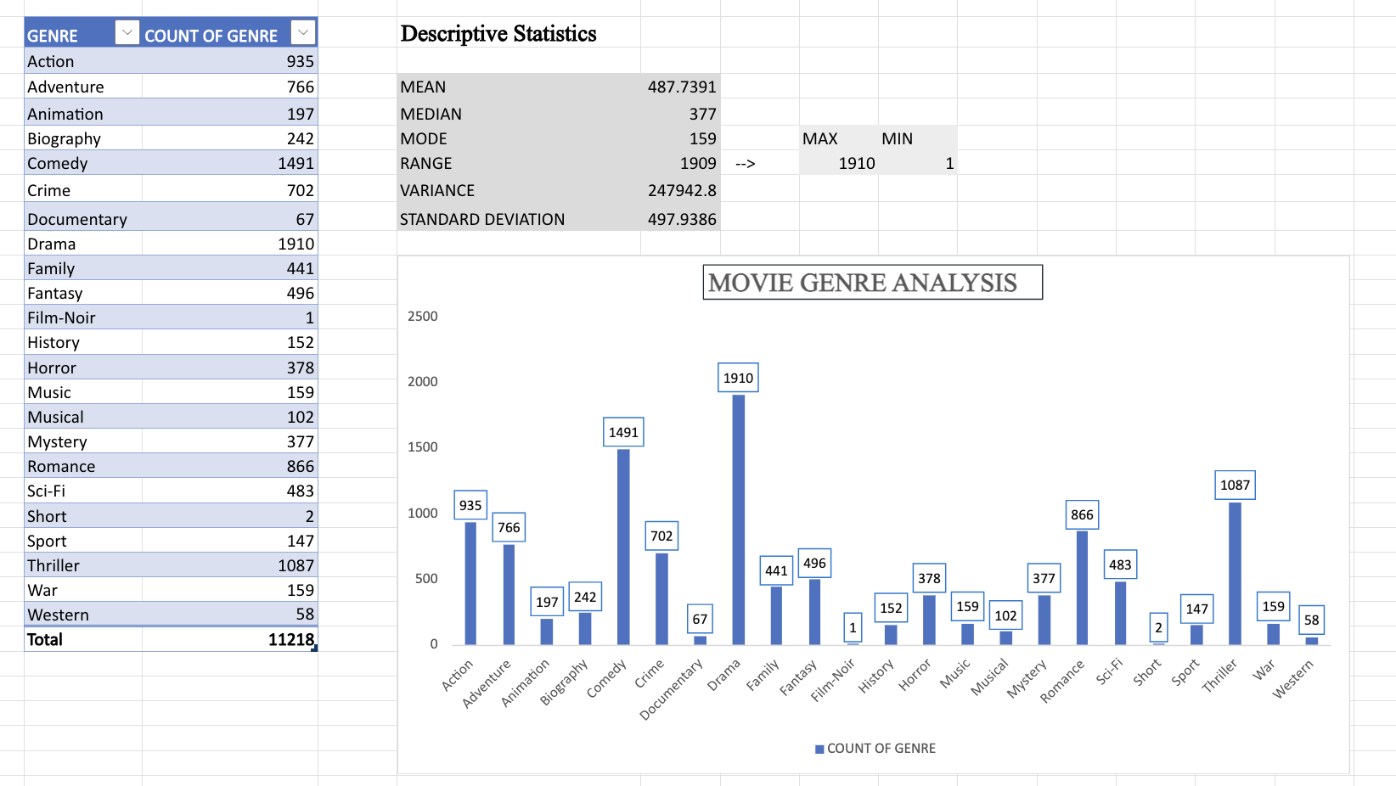
DATA ANALYTIC TASKS:
A. Movie Genre Analysis:

Slide 13
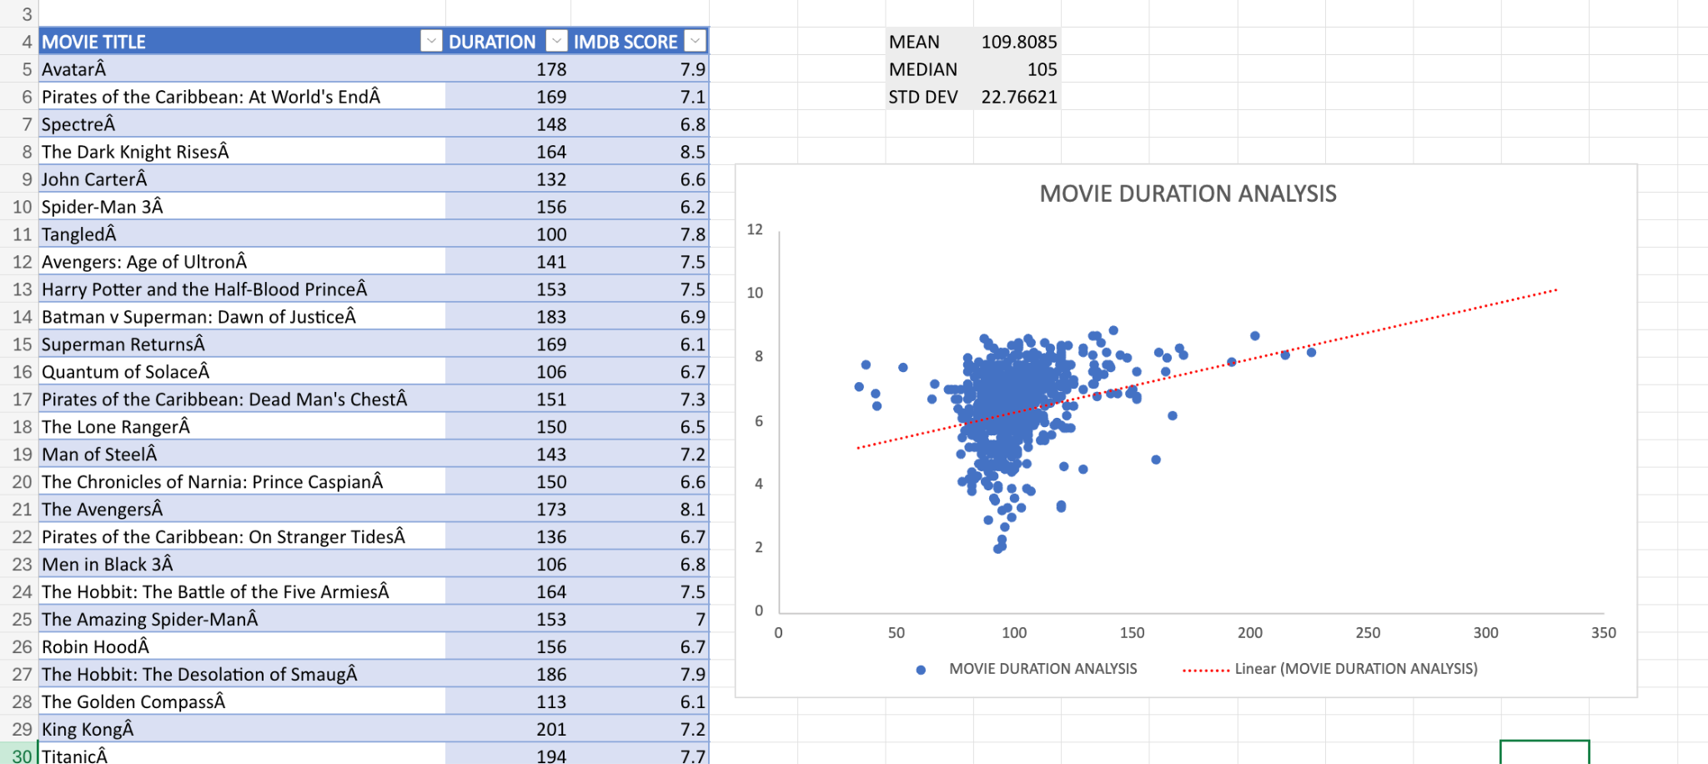
DATA ANALYTIC TASKS:
B. Movie Duration Analysis:
Analyze the distribution of movie durations and identify the relationship between movie duration and IMDB score.

Slide 14
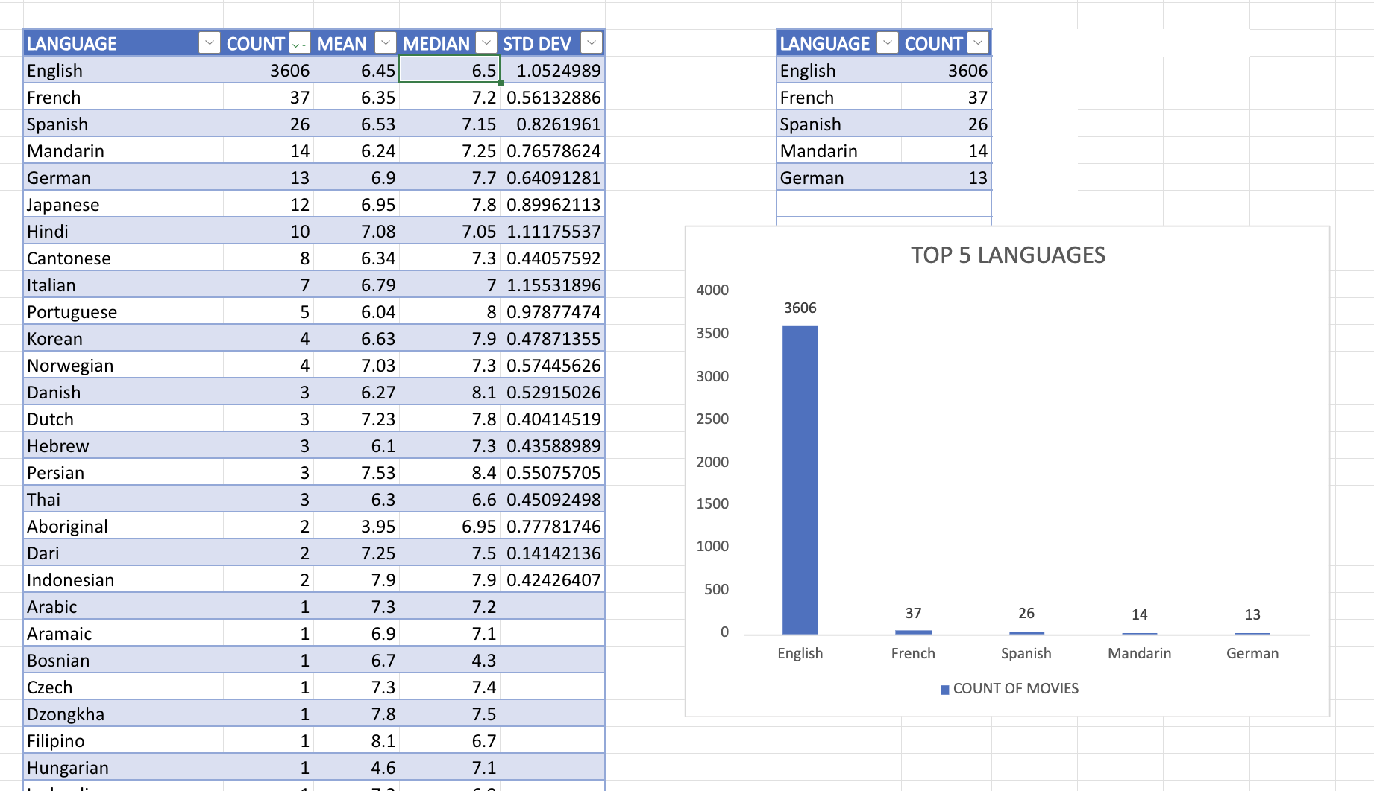
DATA ANALYTIC TASKS:
C. Language Analysis:
Determine the most common languages used in movies and analyze their impact on the IMDB score using descriptive statistics.

Slide 15
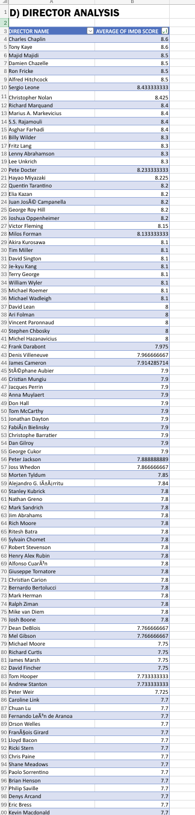
DATA ANALYTIC TASKS:
D. Director Analysis:
Identify the top directors based on their average IMDB score and analyze their contribution to the success of movies using percentile calculations.

Slide 16
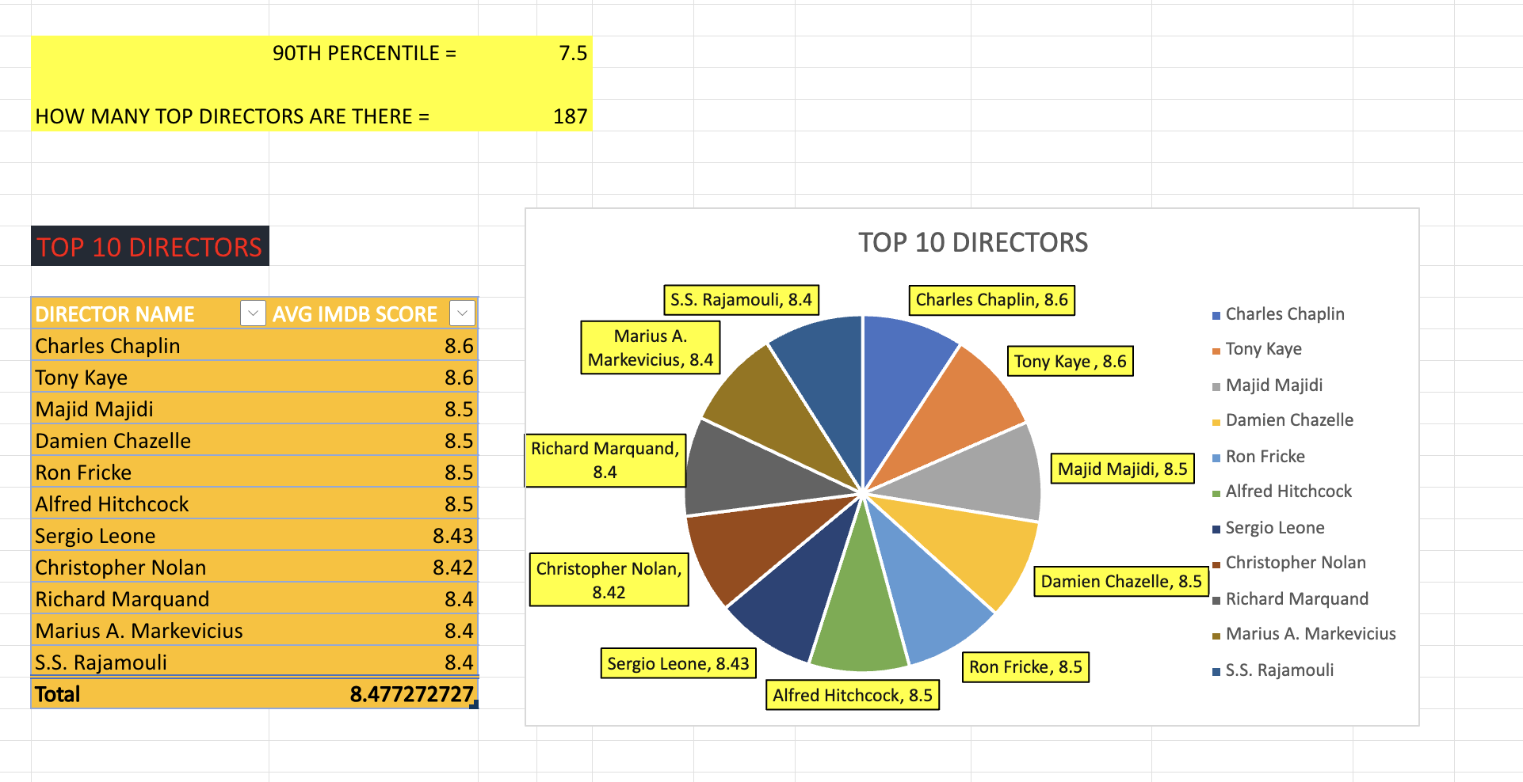
DATA ANALYTIC TASKS:
D. Director Analysis:
Formulas used: =PERCENTILE(Table6[AVERAGE OF IMDB SCORE],0.9)
=COUNTIF(Table6[AVERAGE OF IMDB SCORE],">=7.5")

Slide 17
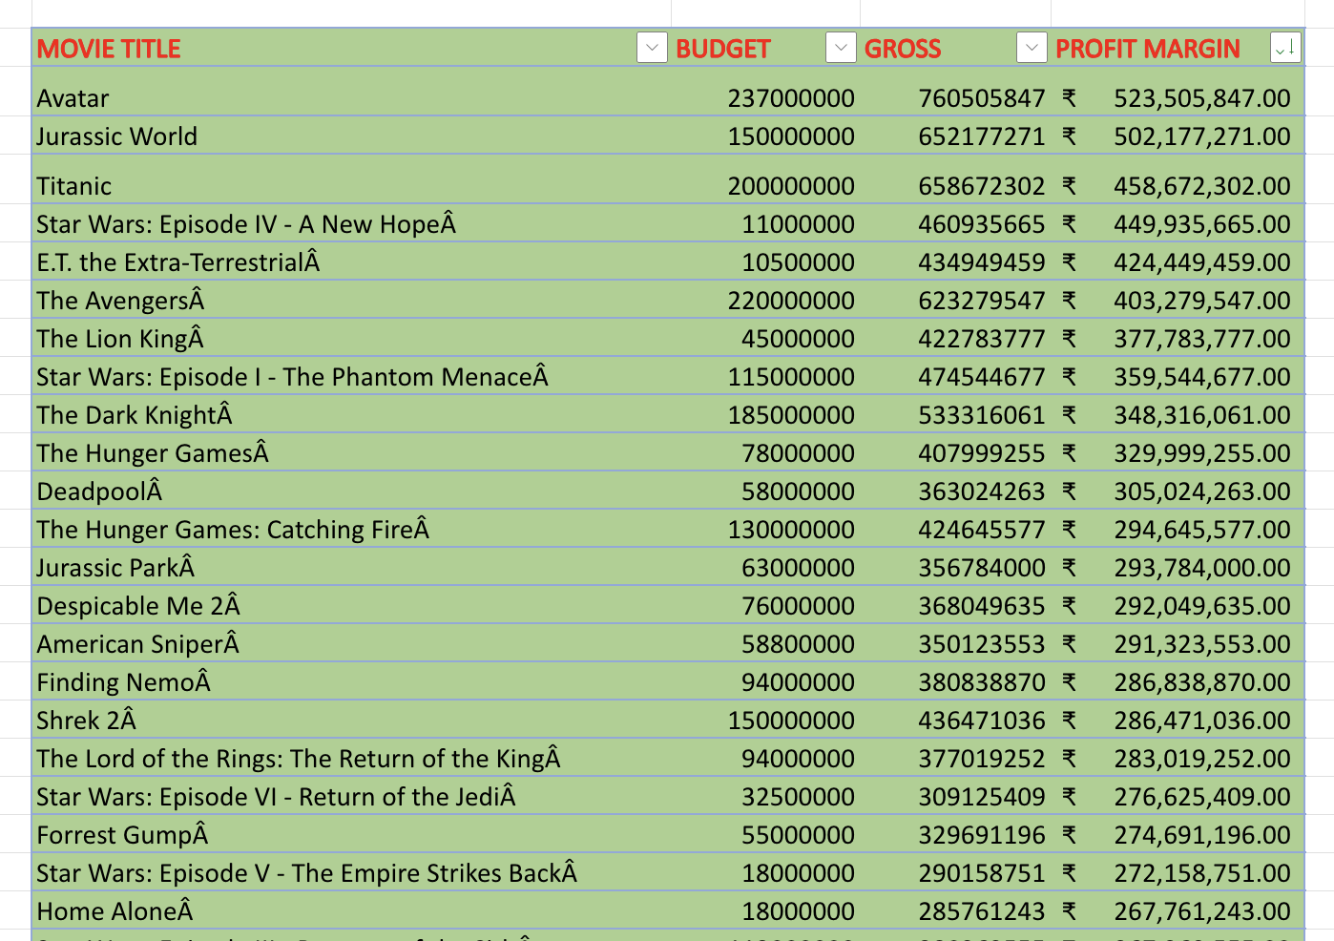
DATA ANALYTIC TASKS:
E. Budget Analysis:
Analyze the correlation between movie budgets and gross earnings, and identify the movies with the highest profit margin.
FORMULAS USED:
=MAX(Table8[PROFIT MARGIN])
=CORREL(Table8[BUDGET],Table8[GROSS])

Slide 18
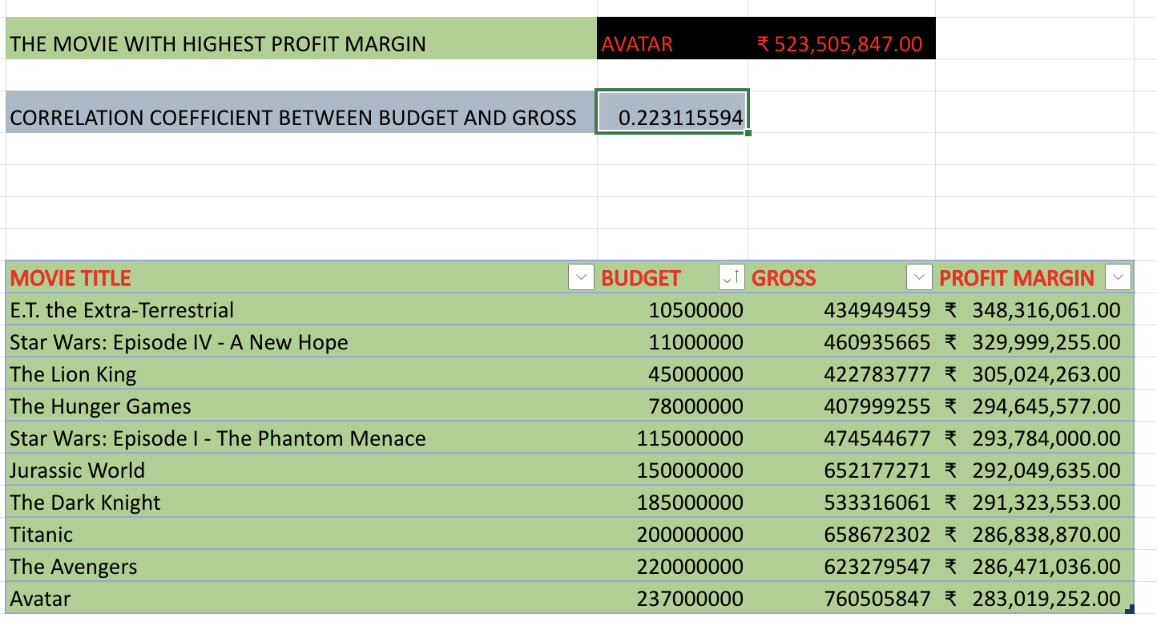
DATA ANALYTIC TASKS:
E. Budget Analysis:

Slide 19
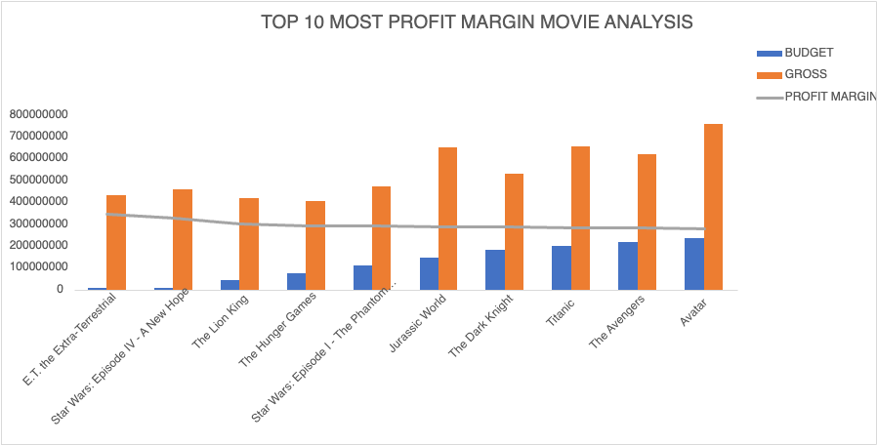
DATA ANALYTIC TASKS:
E. Budget Analysis:

Slide 20
INSIGHTS:
A. Movie Genre Analysis: Analyzed the distribution of movie genres and their impact on the IMDB score.
B. Movie Duration Analysis: Analyzed the distribution of movie durations and its impact on the IMDB score.
C. Language Analysis: Examined the distribution of movies based on their language and analyzed their impact on the IMDB score.
D.Director Analysis: Identified the top directors based on their average IMDB score and analyzed their contribution to the success of movies.
E. Budget Analysis: Explored the relationship between movie budgets and their financial success.

Slide 21
RESULT:
By the Project,I have analyzed Movie Data of different movies containing title,director_name,language, imdb_score, budget, gross etc.
I Identified how each factor is effecting the imdb score and creating profitable margin.
This project had good impact on understanding relation between different variables.

Slide 22
REFERENCE LINK:
The link for excel sheet file:
IMDB_EXCEL

Slide 23
THANK YOU

